Slide 1
Chapter 3
Symmetric Key Crypto
Conducted by:
Dr. Muhammad Iqbal Hossain
Associate Professor
Department of CSE, Brac University
‹#›
Notes:
‹#›

Slide 2
Appendix
Stream Ciphers
Block Ciphers
A5/1
DES
AES
Block Cipher Modes
MAC Integrity
‹#›

Slide 3
Symmetric Key Crypto
Stream cipher ⎯ like a one-time pad
  Key is relatively short
  Key is stretched into a long keystream
  Keystream is then used like a one-time pad except provable security
  Employ confusion only
‹#›
Notes:
Now we are in mordern cryptography. Generalization of One time pad.
Problem in OTP is key size is large.
Practical system, low size key to encrypt mgs.
‹#›

Slide 4
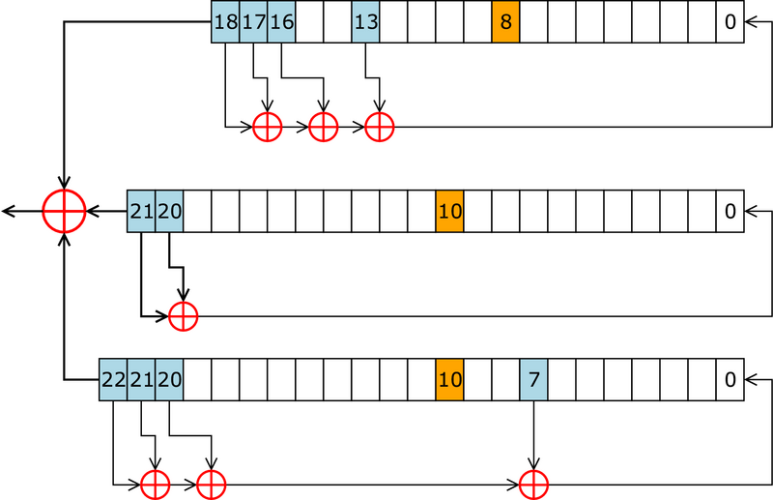
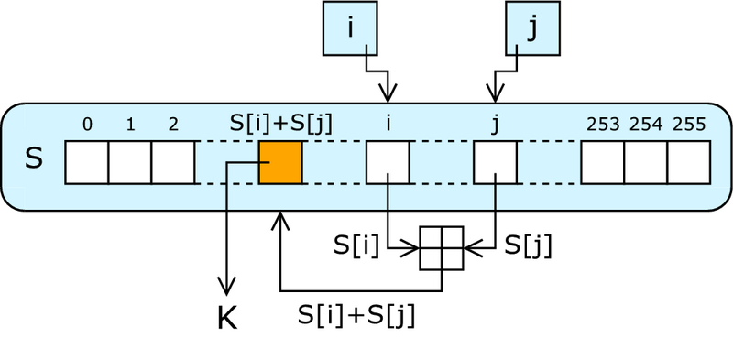
Symmetric Key Crypto
Examples of Stream cipher
  A5/1: employed GSM cell phones
    Representative stream cipher based in H/W (shift register)
  RC4: used SSL protocol (lookup table)
    Almost unique stream cipher since efficiently implemented in S/W
‹#›
Notes:
‹#›

Slide 5
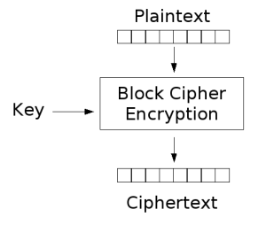
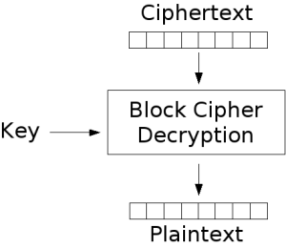
Symmetric Key Crypto
Block cipher ⎯ based on codebook concept
  Block cipher key determines a “electronic” codebook
  Each key yields a different codebook
  Employ both confusion(relation) and diffusion(one-many)
‹#›
Notes:
Statistical attack
So only codebook doesn’t work, not good.
‹#›

Slide 6
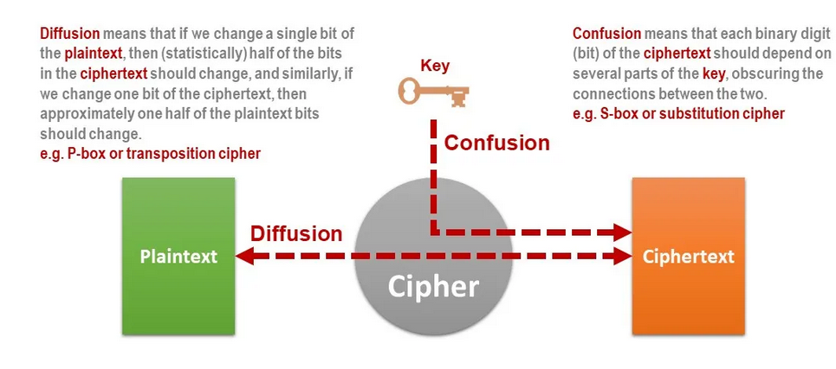
Confusion and Diffusion
‹#›

Slide 7
Symmetric Key Crypto
Examples of Block cipher
  Data Encryption Standard (DES): relatively simple,
  Advanced Encryption STD (AES)
  International Data Encryption Alg.(IEDA)
  Blowfish,
  RC6
  Tiny Encryption Algorithm
‹#›
Notes:
‹#›

Slide 8
Symmetric Key Crypto
Mode of Operation of block cipher
  Examples of block cipher mode Op
    Electronic codebook (EOB)
    Cipher-block chaining (CBC)
    Cipher feedback (CFB)
    Output feedback (OFB)
    Counter (CTR)
Data integrity of block cipher
  Message Authentication code (MAC)
‹#›

Slide 9
Stream Ciphers
Not as popular today as block ciphers
Key K of n bits stretches it into a long keystream
Function of stream cipher
  StreamCipher(K) = S where K:key, S:keystream
  S is used like a one-time pad
    c₀ = p₀ ⊕ s₀, c₁ = p₁ ⊕ s₁, c₂ = p₂ ⊕ s₂, …
    p₀ = c₀ ⊕ s₀, p₁ = c₁ ⊕ s₁, p₂ = c₂ ⊕ s₂, …
Sender and receiver have same stream cipher algorithm and both know the key K
‹#›
Notes:
‹#›

Slide 10
Stream Ciphers
A5/1
  Based on linear feedback shift registers
  Used in GSM mobile phone system
    A5/1 is used in Europe and the United States;
    A5/2, is used in countries that are not considered trustworthy enough to have strong crypto.
RC4
  Based on a changing lookup table
  Used many places – SSL
‹#›
Notes:
We’ll discuss two examples
‹#›

Slide 11
A5/1
    A5/1 is Representative stream cipher based in H/W
Consists of 3 Linear feedback shift registers
  X: 19 bits (x₀, x₁, x₂, …, x₁₈)
  Y: 22 bits (y₀, y₁, y₂, ………, y₂₁)
  Z: 23 bits (z₀, z₁, z₂, ………….,z₂₂)
  X+Y+Z = 64 bits
‹#›
Notes:
We will have 64 bit key.
What we will do,
Load 64 bit to this 3 register and do some processing.
‹#›

Slide 12
A5/1
At each step: m = maj(x₈, y₁₀, z₁₀)
  Examples: maj(0,1,0) = 0 and maj(1,1,0) = 1
If x₈ = m then
  t = x₁₃ ⊕ x₁₆ ⊕ x₁₇ ⊕ x₁₈
  x_{i} = x_{i−1} for i = 18, 17, …, 1 and x₀ = t
If y₁₀ = m then
  t = y₂₀ ⊕ y₂
  y_{i} = y_{i−1} for i = 21, 20, …, 1 and y₀ = t
If z₁₀ = m then
  t = z₇ ⊕ z₂₀ ⊕ z₂₁ ⊕ z₂₂
  z_{i} = z_{i−1} for i = 22, 21, …, 1 and z₀ = t
Keystream bit is x₁₈ ⊕ y₂₁ ⊕ z₂₂
‹#›

Slide 13
A5/1
X
x₀ | x₁ | x₂ | x₃ | x₄ | x₅ | x₆ | x₇ | x₈ | x₉ | x₁₀ | x₁₁ | x₁₂ | x₁₃ | x₁₄ | x₁₅ | x₁₆ | x₁₇ | x₁₈
⊕
Y
y₀ | y₁ | y₂ | y₃ | y₄ | y₅ | y₆ | y₇ | y₈ | y₉ | y₁₀ | y₁₁ | y₁₂ | y₁₃ | y₁₄ | y₁₅ | y₁₆ | y₁₇ | y₁₈ | y₁₉ | y₂₀ | y₂₁
⊕
⊕
Z
z₀ | z₁ | z₂ | z₃ | z₄ | z₅ | z₆ | z₇ | z₈ | z₉ | z₁₀ | z₁₁ | z₁₂ | z₁₃ | z₁₄ | z₁₅ | z₁₆ | z₁₇ | z₁₈ | z₁₉ | z₂₀ | z₂₁ | z₂₂
⊕
Each value is a single bit
Key is used as initial fill of registers
Each register steps or not, based on (x₈, y₁₀, z₁₀)
Keystream bit is XOR of right bits of registers
‹#›
Notes:
Step 1: We calculate maj(x₈, y₁₀, z₁₀). It can be 0 or 1.
Step 2: We check If x₈ = maj() then step otherwise do nothing
Step means EX-OR ing X12, X14, X16, X18, shift 1 bit and put in in X0.
Same for Y and Z.
Step 3: EX-or x18, y21, Z22 and get 1 key bit.
But the beauty is we can similarly generate more and more
‹#›

Slide 14
A5/1
X
1 | 0 | 1 | 0 | 1 | 0 | 1 | 0 | 1 | 0 | 1 | 0 | 1 | 0 | 1 | 0 | 1 | 0 | 1
⊕
Y
1 | 1 | 0 | 0 | 1 | 1 | 0 | 0 | 1 | 1 | 0 | 0 | 1 | 1 | 0 | 0 | 1 | 1 | 0 | 0 | 0 | 1
⊕
⊕
Z
1 | 1 | 1 | 0 | 0 | 0 | 0 | 1 | 1 | 1 | 1 | 0 | 0 | 0 | 0 | 1 | 1 | 1 | 1 | 0 | 0 | 0 | 1
⊕
In this example, m = maj(x₈, y₁₀, z₁₀) = maj(1,0,1) = 1
Register X steps, Y does not step, and Z steps
Keystream bit is XOR of right bits of registers
Here, keystream bit will be 0 ⊕ 1 ⊕ 0 = 1
‹#›
Notes:
Seems a lot of work but implement with HW it will create 1 bit in a clock tik.
‹#›

Slide 15
Shift Register Crypto
Shift register crypto efficient in hardware
Often, slow if implemented in software
In the past, very, very popular
Today, more is done in software due to fast processors
Shift register crypto still used some
  Especially in resource-constrained devices
‹#›

Slide 16
RC4
A self-modifying lookup table
Table always contains a permutation of the byte values 0,1,…,255
Initialize the permutation using key
At each step, RC4 does the following
  Swaps elements in current lookup table
  Selects a keystream byte from table
Each step of RC4 produces a byte
  Efficient in software
Each step of A5/1 produces only a bit
  Efficient in hardware
‹#›

Slide 17
RC4
RC4 Optimized for software implementation, whereas A5/1 for hardware
RC4 produces a keystream BYTE at each step, whereas A5/1 only produce a single keystream bit
‹#›

Slide 18
RC4
RC4 is remarkably simple
  Because it is essentially just lookup table containing permutation of the 256(2⁸)-byte values
  Each time a byte of keystream is produced, the lookup table is modified in such a way that the table always contains a permutation of {0,1,2,…256}
‹#›

Slide 19
Stream Ciphers
Stream ciphers were big in the past
  Efficient in hardware
  Speed needed to keep up with voice, etc.
  Today, processors are fast, so software-based crypto is fast enough
Future of stream ciphers?
  Shamir: “the death of stream ciphers”
  May be exaggerated…
‹#›
Notes:
Rovest
Shamir
Low powered devices we can use stream cipher
‹#›

Slide 20
End of segment
‹#›

Slide 21
Block Ciphers
BLOCK CIPHER AND DES
‹#›

Slide 22
Block Cipher
Plaintext and ciphertext consists of fixed sized blocks
Design goal: security and efficiency
  It is not easy to design a block cipher that is secure and efficient
‹#›
Notes:
‹#›

Slide 23
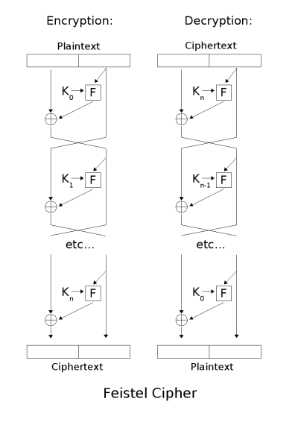
(Iterated) Block Cipher
Plaintext and Ciphertext consist of fixed-sized blocks
Ciphertext obtained from plaintext by iterating a round function
Input to round function consists of key and the output of previous round
Usually implemented in software
Typical Type is Feistel Cipher
‹#›
Notes:
Take a block of bit, look at up to codebook and find corresponding cipher blocl.
Block size 64, 128.
‹#›

Slide 24
Data Encryption Standard (DES)
DES developed in 1970’s
Based on IBM Lucifer cipher
U.S. government standard
DES development was controversial
  NSA was secretly involved
  Design process not open
  Key length was reduced
  Subtle changes to Lucifer algorithm
‹#›
Notes:
World’s most famous Feistel cipher
The Data Encryption Standard, affectionately known as DES,2 was developed way back in the computing dark ages of the 1970s. The design is based on the
so-called Lucifer cipher, a Feistel cipher developed by a team at IBM. DES is a surprisingly simple block cipher, but the story of how Lucifer became DES
is anything but simple.
In the mid 1970s, crypto was poorly understood outside of classified military and government circles, and they weren't talking (and, for the most part, that's still the case). The upshot was that businesses had no way to judge the merits of a crypto product and the quality of most such products was very poor.
Into this environment, the National Bureau of Standards, or NBS (now known as NIST) issued a request for cipher proposals. The winning submission would become a U.S. government standard and almost certainly a de facto industrial standard. Very few reasonable submissions were received, and it quickly became apparent that IBM's Lucifer cipher was the only serious contender.
The NSA was reluctant to get involved with DES but, under pressure, eventually agreed to study the Lucifer design and offer an opinion, provided its role would not become public. When this information came to public light [273] (as is inevitable in the United States4) many were suspicious that NSA had placed a backdoor into DES so that it alone could break the cipher.
‹#›

Slide 25
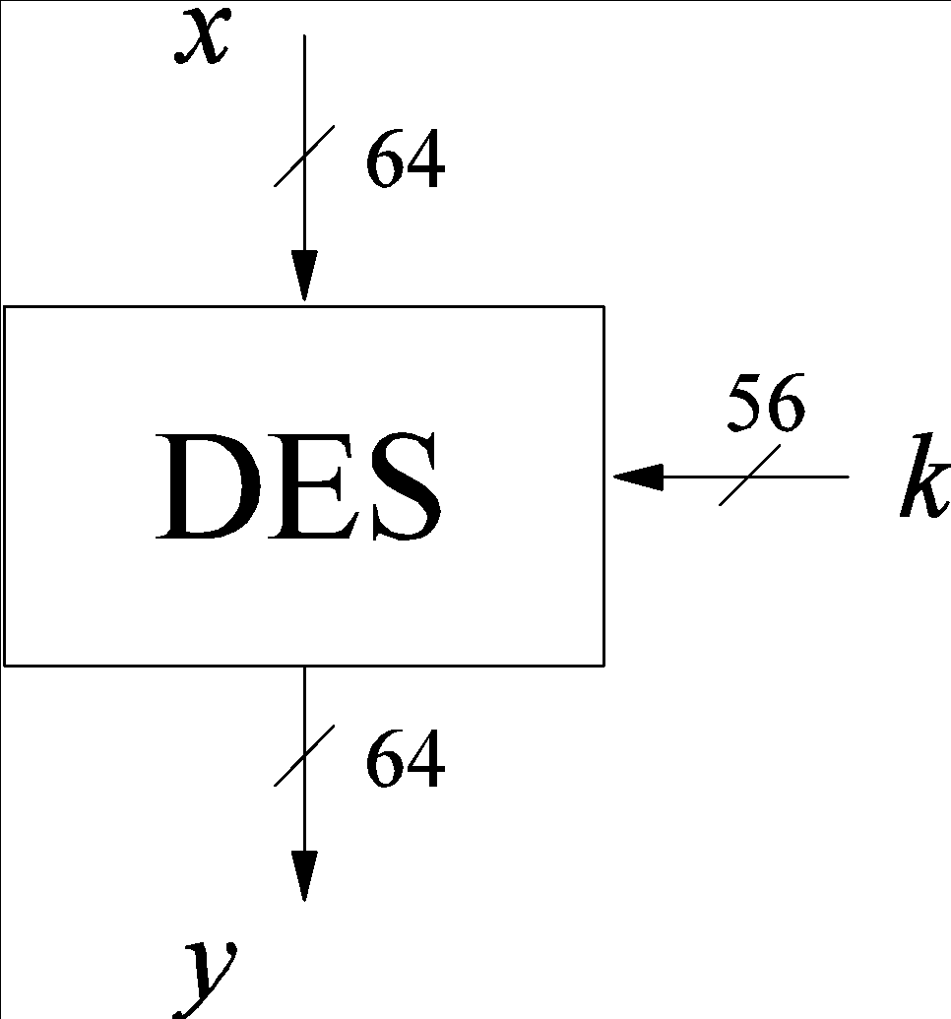
DES Numerology
DES is a Feistel cipher
  64 bit block length
  56 bit key length
  16 rounds
  48 bits of key used each round (subkey)
Each round is simple (for a block cipher)
Security depends primarily on “S-boxes”
  Each S-boxes maps 6 bits to 4 bits
  Total 8 S-boxes
‹#›
Notes:
‹#›

Slide 26
One Round of DES
L
R
key
32
32
28
28
L
R
expend
28
28
48
48
Compress
48
S-boxes(8)
32
28
28
P Box
32
32
32
L
R
key
‹#›

Slide 27
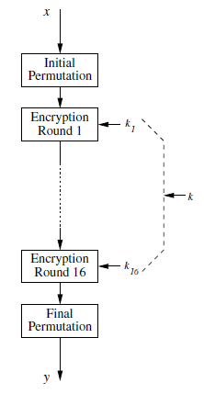
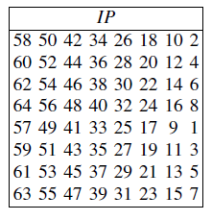
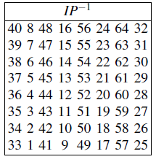
Initial permutation
‹#›

Slide 28
DES Expansion Permutation
32
expend
Input 32 bits
48
index
0 | 1 | 2 | 3 | 4 | 5 | 6 | 7 | 8 | 9 | 10 | 11 | 12 | 13 | 14 | 15
1 | 1 | 0 | 0 | 1 | 0 | 1 | 1 | 1 | 0 | 0 | 1 | 0 | 0 | 0 | 1
16 | 17 | 18 | 19 | 20 | 21 | 22 | 23 | 24 | 25 | 26 | 27 | 28 | 29 | 30 | 31
0 | 1 | 1 | 0 | 0 | 1 | 1 | 1 | 1 | 0 | 0 | 1 | 0 | 0 | 1 | 1
index
Output 48 bits
index
0 | 1 | 2 | 3 | 4 | 5 | 6 | 7 | 8 | 9 | 10 | 11
12 | 13 | 14 | 15 | 16 | 17 | 18 | 19 | 20 | 21 | 22 | 23
24 | 25 | 26 | 27 | 28 | 29 | 30 | 31 | 32 | 33 | 34 | 35
36 | 37 | 38 | 39 | 40 | 41 | 42 | 43 | 44 | 45 | 46 | 47
index
index
index
‹#›
Notes:
Oytput: 4 * 12 = 48
‹#›

Slide 29
DES Expansion Permutation
Input 32 bits
index
0 | 1 | 2 | 3 | 4 | 5 | 6 | 7 | 8 | 9 | 10 | 11 | 12 | 13 | 14 | 15
1 | 1 | 0 | 0 | 1 | 0 | 1 | 1 | 1 | 0 | 0 | 1 | 0 | 0 | 0 | 1
16 | 17 | 18 | 19 | 20 | 21 | 22 | 23 | 24 | 25 | 26 | 27 | 28 | 29 | 30 | 31
0 | 1 | 1 | 0 | 0 | 1 | 1 | 1 | 1 | 0 | 0 | 1 | 0 | 0 | 1 | 1
index
Output 48 bits
index
0 | 1 | 2 | 3 | 4 | 5 | 6 | 7 | 8 | 9 | 10 | 11
31 | 0 | 1 | 2 | 3 | 4 | 3 | 4 | 5 | 6 | 7 | 8
12 | 13 | 14 | 15 | 16 | 17 | 18 | 19 | 20 | 21 | 22 | 23
7 | 8 | 9 | 10 | 11 | 12 | 11 | 12 | 13 | 14 | 15 | 16
24 | 25 | 26 | 27 | 28 | 29 | 30 | 31 | 32 | 33 | 34 | 35
15 | 16 | 17 | 18 | 19 | 20 | 19 | 20 | 21 | 22 | 23 | 24
36 | 37 | 38 | 39 | 40 | 41 | 42 | 43 | 44 | 45 | 46 | 47
23 | 24 | 25 | 26 | 27 | 28 | 27 | 28 | 29 | 30 | 31 | 0
index
index
index
‹#›

Slide 30
DES S-box
6
6
6
6
6
6
6
6
S-boxes(8)
8 “substitution boxes” or S-boxes
Each S-box maps 6 bits to 4 bits
S-box number 1
4
4
4
4
4
4
4
4
input bits (0,5)
↓
input bits (1,2,3,4)
 | 00 00 | 00 01 | 00 10 | 00 11 | 01 00 | 01 01 | 01 10 | 01 11 | 10 00 | 10 01 | 10 10 | 10 11 | 11 00 | 11 01 | 11 10 | 11 11
00 | 11 10 | 01 00 | 11 01 | 00 01 | 00 10 | 11 11 | 10 11 | 10 00 | 00 11 | 10 10 | 01 10 | 11 00 | 01 01 | 10 01 | 00 00 | 01 11
01 | 00 00 | 11 11 | 01 11 | 01 00 | 11 10 | 00 10 | 11 01 | 00 01 | 10 10 | 01 10 | 11 00 | 10 11 | 10 01 | 01 01 | 00 11 | 10 00
10 | 01 00 | 11 01 | 11 10 | 10 00 | 11 01 | 01 10 | 00 10 | 10 11 | 11 11 | 11 00 | 10 01 | 01 11 | 00 11 | 10 10 | 01 01 | 00 00
11 | 11 11 | 11 00 | 10 00 | 00 10 | 01 00 | 10 01 | 00 01 | 01 11 | 01 11 | 10 11 | 00 11 | 11 10 | 10 10 | 00 00 | 01 10 | 11 01
‹#›
Notes:
[1 0 1 1 0 1]
[1 1]
[0 1 1 0]
‹#›

Slide 31
DES P-box
32
P Box
32
Input 32 bits
0 | 1 | 2 | 3 | 4 | 5 | 6 | 7 | 8 | 9 | 10 | 11 | 12 | 13 | 14 | 15
16 | 17 | 18 | 19 | 20 | 21 | 22 | 23 | 24 | 25 | 26 | 27 | 28 | 29 | 30 | 31
Output 32 bits
15 | 6 | 19 | 20 | 28 | 11 | 27 | 16 | 0 | 14 | 22 | 25 | 4 | 17 | 30 | 9
1 | 7 | 23 | 13 | 31 | 26 | 2 | 8 | 18 | 12 | 29 | 5 | 21 | 10 | 3 | 24
BACK
‹#›

Slide 32
DES subkey
L
R
key
32
32
28
28
L
R
expend
28
28
48
48
Compress
48
S-boxes(8)
32
28
28
P Box
32
32
32
L
R
key
‹#›

Slide 33
DES Subkey
56 bit DES key, numbered 0,1,2,…,55
Left half key bits, LK
49 | 42 | 35 | 28 | 21 | 14 | 7
0 | 50 | 43 | 36 | 29 | 22 | 15
8 | 1 | 51 | 44 | 37 | 30 | 23
16 | 9 | 2 | 52 | 45 | 38 | 31
Right half key bits, RK
55 | 48 | 41 | 34 | 27 | 20 | 13
6 | 54 | 47 | 40 | 33 | 26 | 19
12 | 5 | 53 | 46 | 39 | 32 | 25
18 | 11 | 4 | 24 | 17 | 10 | 3
‹#›

Slide 34
DES Subkey
For rounds i=1,2,...,16
  Let LK = (LK circular shift left by r_{i})
  Let RK = (RK circular shift left by r_{i})
  Left half of subkey K_{i} is of LK bits
13 16 10 23 0 4 2 27 14 5 20 9
22 18 11 3 25 7 15 6 26 19 12 1
  Right half of subkey K_{i} is RK bits
12 23 2 8 18 26 1 11 22 16 4 19
15 20 10 27 5 24 17 13 21 7 0 3
‹#›

Slide 35
DES Subkey
For rounds 1, 2, 9 and 16 the shift r_{i} is 1, and in all other rounds r_{i} is 2
Bits 8,17,21,24 of LK omitted each round
Bits 6,9,14,25 of RK omitted each round
Compression permutation yields 48 bit subkey K_{i} from 56 bits of LK and RK
Key schedule generates subkey
BACK
‹#›

Slide 36
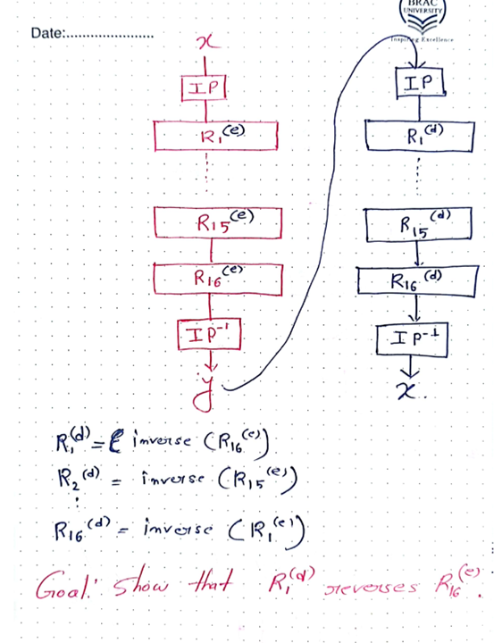
Decryption???
‹#›

Slide 37
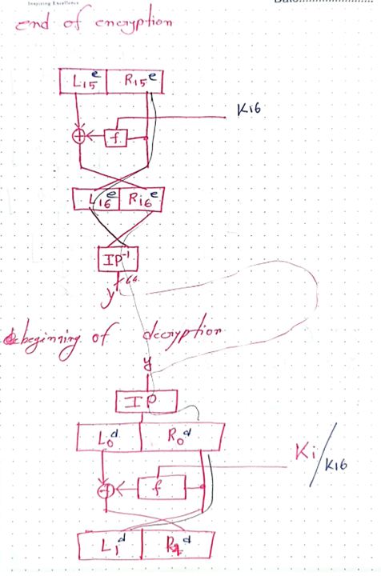

Slide 38
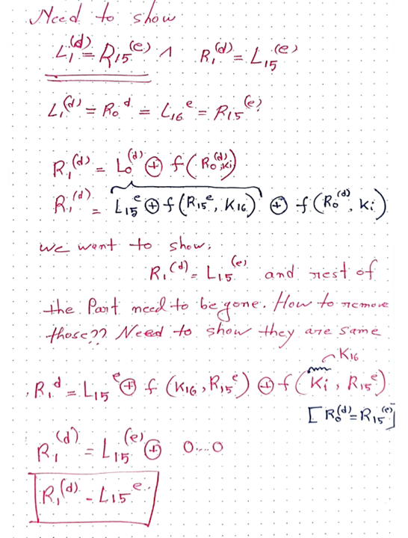

Slide 39
Security of DES
Security of DES depends a lot on S-boxes
  Everything else in DES is linear
Thirty years of intense analysis has revealed no “back door”
Attacks today use exhaustive key search
Inescapable conclusions
  Designers of DES knew what they were doing
  Designers of DES were ahead of their time
‹#›

Slide 40
DES Last Word (Almost)
An initial perm P before round 1
Halves are swapped after last round
A final permutation (inverse of P) is applied to (R₁₆,L₁₆) to yield ciphertext
None of these serve any security purpose
‹#›
Notes:
‹#›

Slide 41
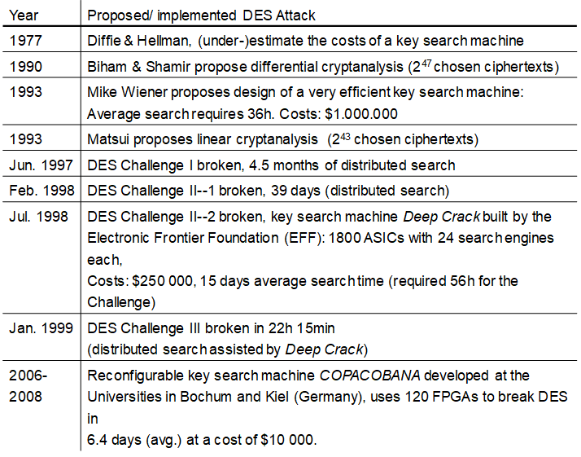
History of Attacks on DES
‹#›

Slide 42
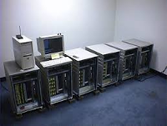
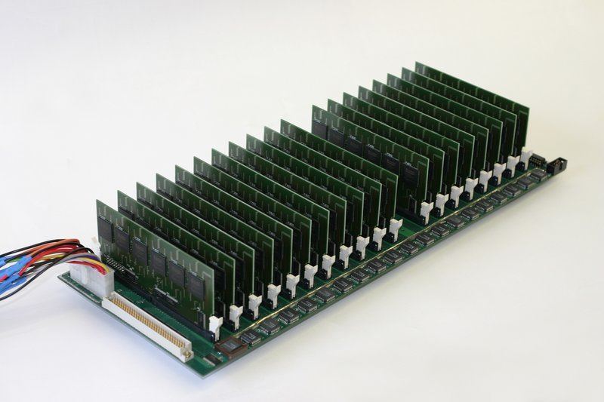
Deep Crack
Copacabana

Slide 43
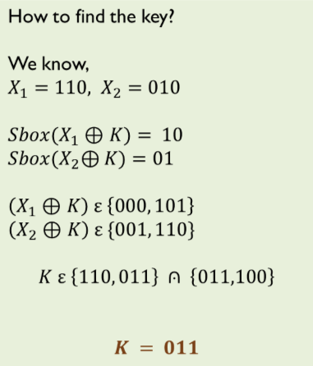
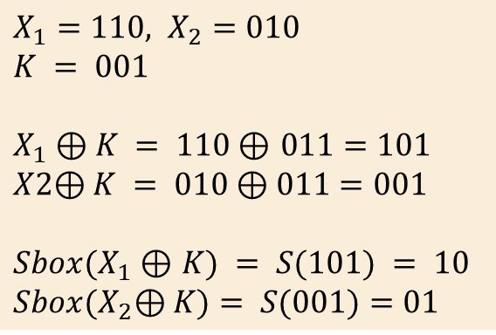
Cryptanalysis of DES
Breaking S-BOX
Sample S-box
 | 00 | 01 | 10 | 11
0 | 10 | 01 | 11 | 00
1 | 00 | 10 | 01 | 11
011
‹#›

Slide 44
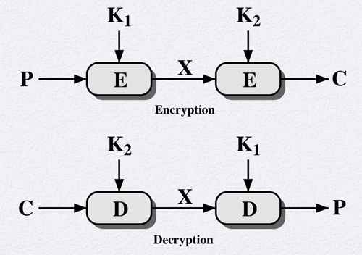
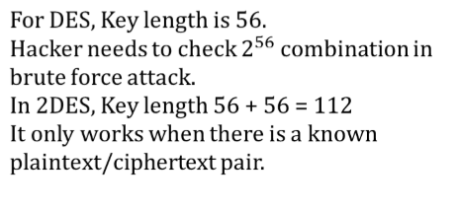
Double DES and meet in the middle attack
1. Encrypt the plaintext with all 2⁵⁶ possible keys and write down the results
2. Decrypt the ciphertext with all 2⁵⁶ possible keys and write down the results
3. Check where the results are the same. That is your key.
Note that all you had to do to recover the key was using DES 2 × 2⁵⁶ times, which makes 2⁵⁷.
‹#›
Notes:
It only works when there is a known plaintext/ciphertext pair. The attacker first encrypts the plaintext with all possible values for the first key and stores the results in a sorted table. Next, the ciphertext is decrypted using all possible values of the second key while checking each decryption in the table for a match. Once a match is found, the two keys are used against a new known plaintext/ciphertext pair to ensure the keys are correct.
‹#›

Slide 45
Thank you
‹#›

Slide 46
Block Cipher: AES
‹#›

Slide 47
Advanced Encryption Standard (AES ) History
Needs for replacement for DES
  DES had outlived its usefulness
    Attacked by exhaustive key search: Special purpose DES crackers and distributed attack at internet
  3DES is very resistant to crypto analysis but
    No efficient software code
    Too slow: 3 times as many rounds as DES
    3DES use 64-bit block size: for reasons of both efficient and security, a larger blk sixe desirable
    So, 3DES is not solution for long-term use
In 1997, NIST made a formal call for advanced encryption standard algorithms
‹#›

Slide 48
Advanced Encryption Standard (AES ) History
GOAL: replace DES for both government and private sector encryption.
Requirement of AES
  Unclassified, publicly disclosed encryption algorithm, available royalty-free, worldwide.
  The algorithm must implement symmetric key
  Cryptography as a block cipher and (at a minimum) support block sizes of 128-bits and key sizes of 128- , 192-, and 256-bits.
In 1998, NIST announced a group of 15 AES candidate algorithms.
‹#›

Slide 49
AES History
Criteria for selecting AES:
  Security, Robustness, Speed
In 1999, out of 15, the selection was narrowed to 5 candidates:
  MARS, RC6, Rijndael, Serpent, and Twofish.
All the five protocols were thought to be secure
On October 2, 2000, NIST has selected Rijndael to propose for the AES.
  Pronounced like “Rain Doll” or “Rhine Doll”
  Invented by Joan Daemen and Vincent Rijmen
‹#›
Notes:
5 finalists announced in August, 1999:
Mars – IBM Corporation
RC6 – RSA Laboratories
Rijndael – J. Daemen & V. Rijmen
Serpent – Eli Biham et al.
Twofish – B. Schneier et al.
‹#›

Slide 50
AES Features
Designed to be efficient in both hardware and software across a variety of platforms.
Not a Feistel Network
  Iterated block cipher (like DES)
  Not a Feistel cipher (unlike DES)
  “Secure forever” – Shamir
‹#›

Slide 51
AES Overview
Block size: 128 bits (others in Rijndael)
Key length: 128, 192 or 256 bits (independent of block size in Rijndael)
10 to 14 rounds (depends on key length)
Each round uses 4 functions (3 “layers”)
  ByteSub (nonlinear layer)
  ShiftRow (linear mixing layer)
  MixColumn (nonlinear layer)
  AddRoundKey (key addition layer)
‹#›

Slide 52
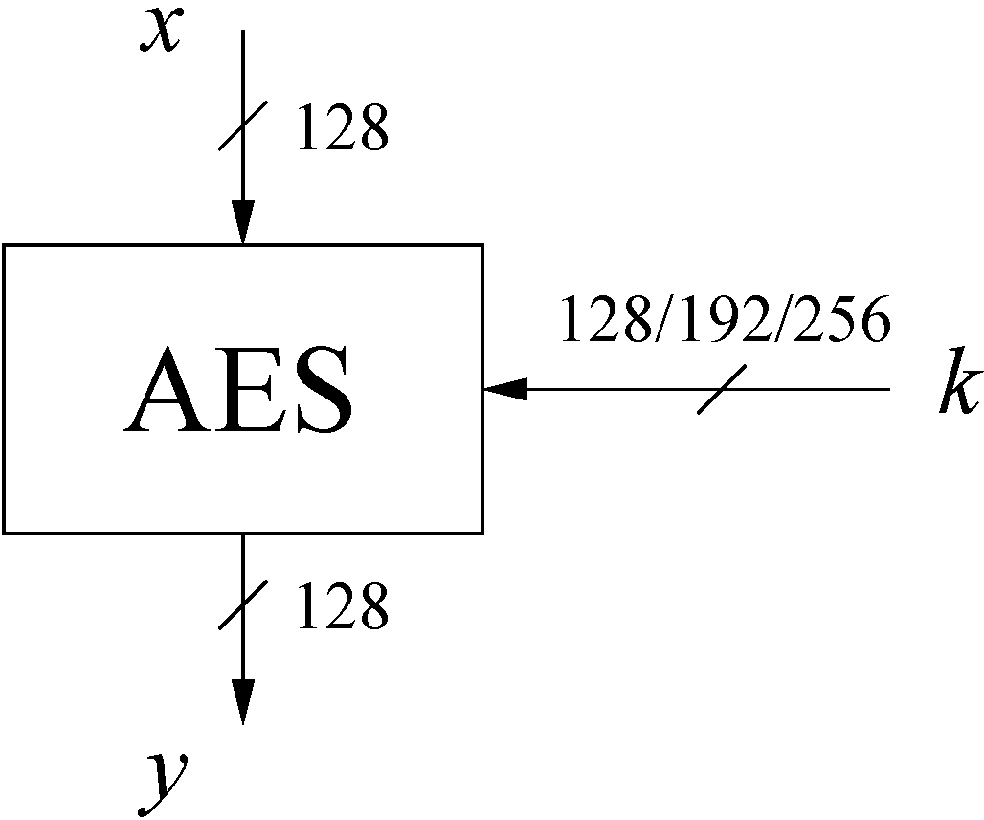
AES: Overview
The number of rounds depends on the chosen key length:
Key length (bits) | Number of rounds
128 | 10
192 | 12
256 | 14
‹#›

Slide 53
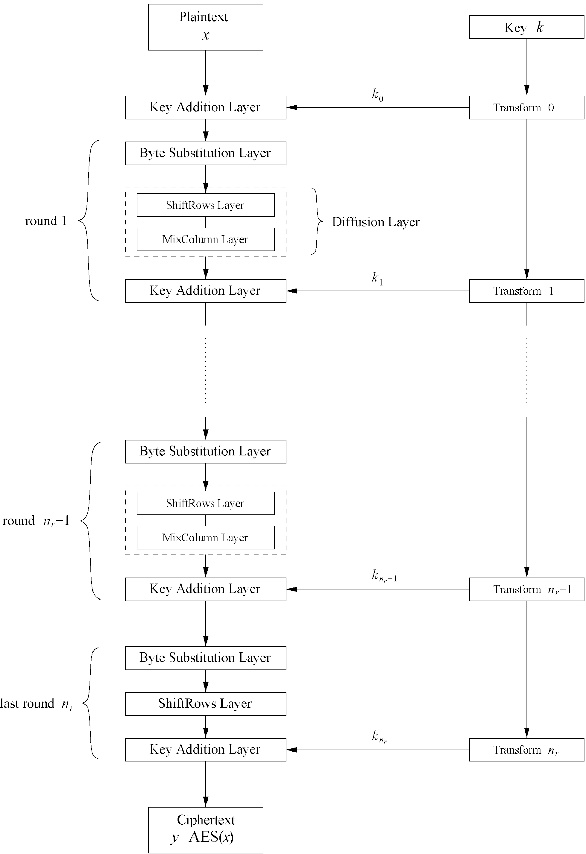
AES: Overview
‹#›

Slide 54
‹#›

Slide 55
Internal Structure of AES
AES is a byte-oriented cipher
The state A (i.e., the 128-bit data path) can be arranged in a 4x4 matrix:
with A₀,…, A₁₅ denoting the 16-byte input of AES
A₀ | A₄ | A₈ | A₁₂
A₁ | A₅ | A₉ | A₁₃
A₂ | A₆ | A₁₀ | A₁₄
A₃ | A₇ | A₁₁ | A₁₅
A₀,…, A₁₅ Contain HEX number.
For example: A₀=C2, A₂=EA ...
‹#›

Slide 56
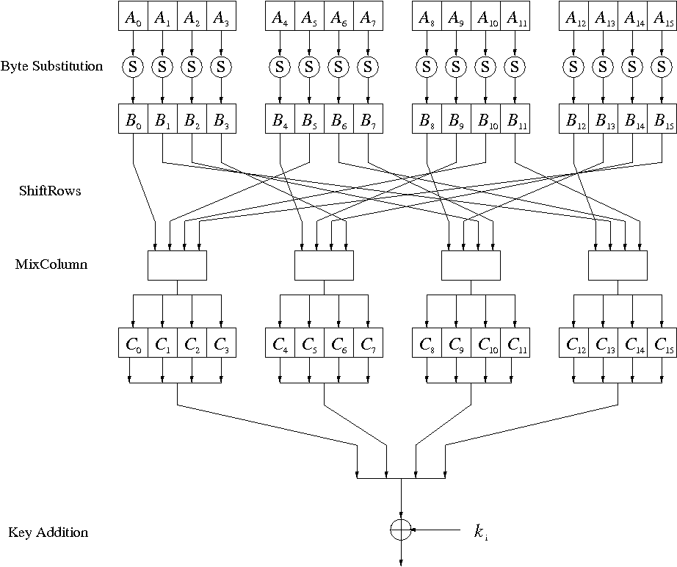
Internal Structure of AES
‹#›/28

Slide 57
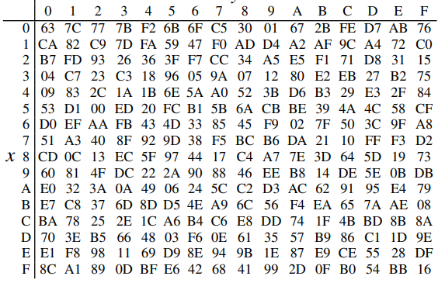
Byte Substitution
Let’s assume the input byte to the S-Box is Ai = (C2)hex,
then the substituted value is S((C2)hex) = (25)hex.
‹#›/28

Slide 58
Shiftrows and MixColumn
‹#›/28

Slide 59
ShiftRows Sublayer
Rows of the state matrix are shifted cyclically:
Input matrix
Output matrix
B₀ | B₄ | B₈ | B₁₂
B₁ | B₅ | B₉ | B₁₃
B₂ | B₆ | B₁₀ | B₁₄
B₃ | B₇ | B₁₁ | B₁₅
B₀ | B₄ | B₈ | B₁₂
B₅ | B₉ | B₁₃ | B₁
B₁₀ | B₁₄ | B₂ | B₆
B₁₅ | B₃ | B₇ | B₁₁
no shift
← one position left shift
← two positions left shift
← three positions left shift
‹#›/28

Slide 60
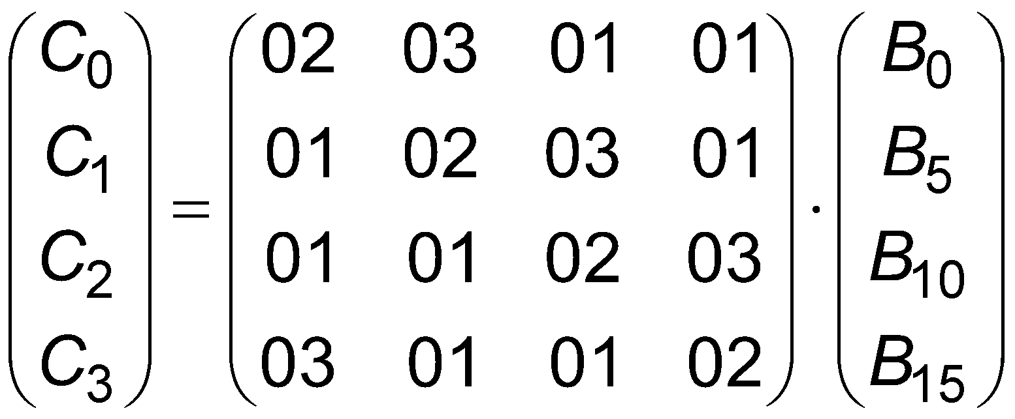
MixColumn Sublayer
Each 4-byte column is considered as a vector and multiplied
by a fixed 4x4 matrix, e.g.,
B₀ | B₄ | B₈ | B₁₂
B₅ | B₉ | B₁₃ | B₁
B₁₀ | B₁₄ | B₂ | B₆
B₁₅ | B₃ | B₇ | B₁₁
Output matrix
‹#›

Slide 61
Key Addition Layer
Inputs:
  128bit/16-byte state matrix C
  128bit/ 16-byte subkey k_{i}
Output: C ⊕ k_{i}
The subkeys are generated in the key schedule
‹#›/28

Slide 62
Key Schedule
‹#›

Slide 63
Example
Plain text
T | w | o |  | O | n | e |  | N | i | n | e |  | T | w | o
54 | 77 | 6F | 20 | 4F | 6E | 65 | 20 | 43 | 69 | 6E | 25 | 20 | 54 | 77 | 6F
Key
T | h | a | t | s |  | m | y |  | K | u | n | g |  | F | u
54 | 68 | 61 | 74 | 73 | 20 | 6D | 79 | 20 | 4B | 75 | 6E | 67 | 20 | 46 | 75
‹#›

Slide 64
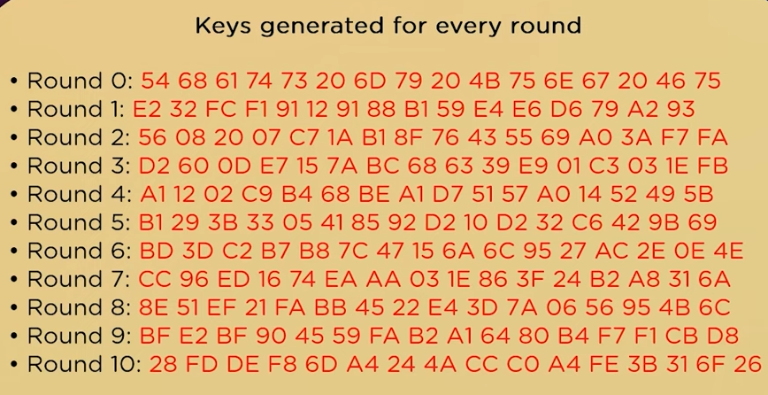
‹#›

Slide 65
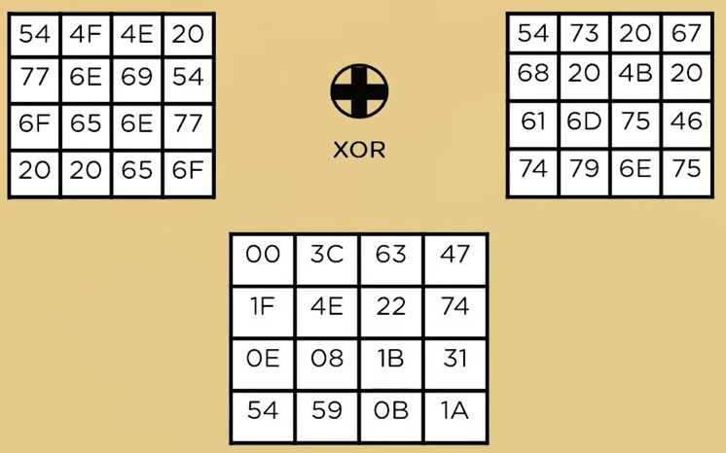
Step 1: Key Addition
‹#›

Slide 66
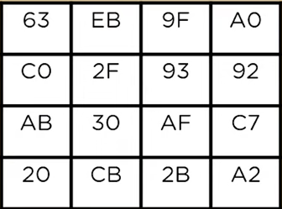
Step 2: Byte substitution
‹#›

Slide 67
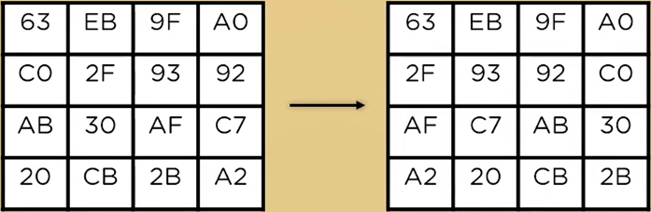
Step 3: Shift Row
‹#›

Slide 68
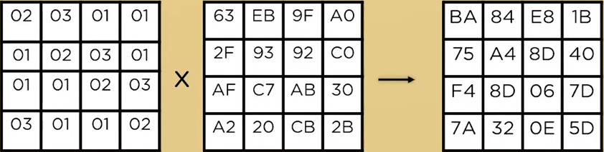
Step 4: Mix column
‹#›

Slide 69
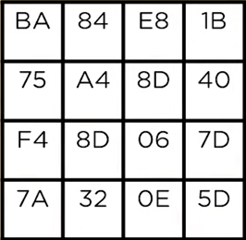
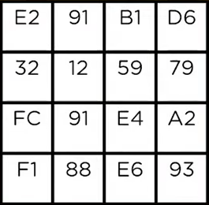
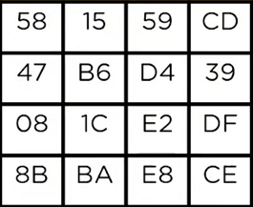
Step 5: Add round key
⊕
=
Input of next round
‹#›

Slide 70
Key Generation
‹#›

Slide 71
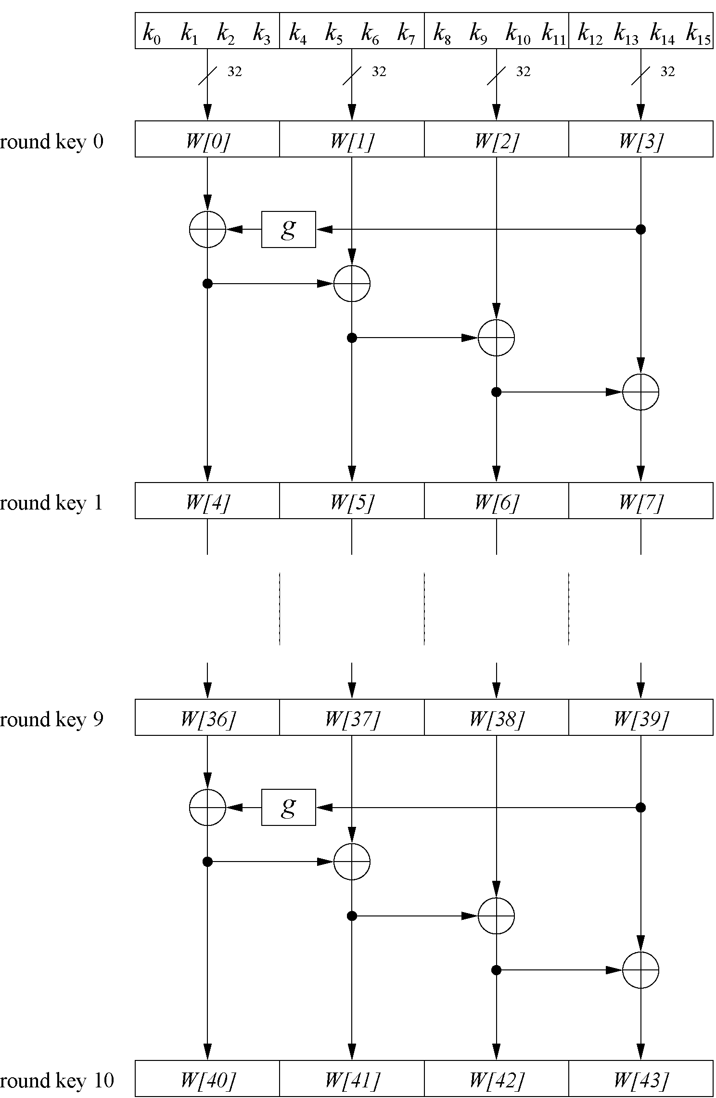
Example: Key schedule for 128-bit key AES
Word-oriented: 1 word = 32 bits
11 subkeys are stored in W[0]…W[3], W[4]…W[7], … , W[40]…W[43]
First subkey W[0]…W[3] is the original AES key
‹#›/28

Slide 72
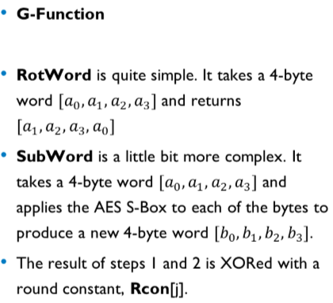
‹#›/28

Slide 73
This question is about the Key Schedule of AES algorithm.
Let's assume the initial key is: (W[0] W[1] W[2] W[3]) = (4A C6 9E 45) and the Round constant is 00 01 10 11.
You need to use the S-box of AES.
W[4] = W[0] ⊕ g(W[3])
W[5] = W[1] ⊕ W[4]
W[6] = W[2] ⊕ W[5]
W[7] = W[3] ⊕ W[6]
W[4] = 4A ⊕ g(W[3]) = 01001010 ⊕ 00111011
=01110001 = 71
W[5] = C6 ⊕ 71 = 11000110 ⊕ 01110001
=10110111 = B7
And so on…
g(W[3]) = g(45)
Step 1:
Rotate W[3] i.e 45 becomes 54
Step 2:
S-box(54) = 20
Step 3:
20 ⊕ RC
= 00100000 ⊕ 00011011
=00111011 = g(W[3])
‹#›

Slide 74
AES Decryption
To decrypt, process must be invertible
Inverse of MixAddRoundKey is easy, since “⊕” is its own inverse
MixColumn is invertible (inverse is also implemented as a lookup table)
Inverse of ShiftRow is easy (cyclic shift the other direction)
ByteSub is invertible (inverse is also implemented as a lookup table)
‹#›

Slide 75
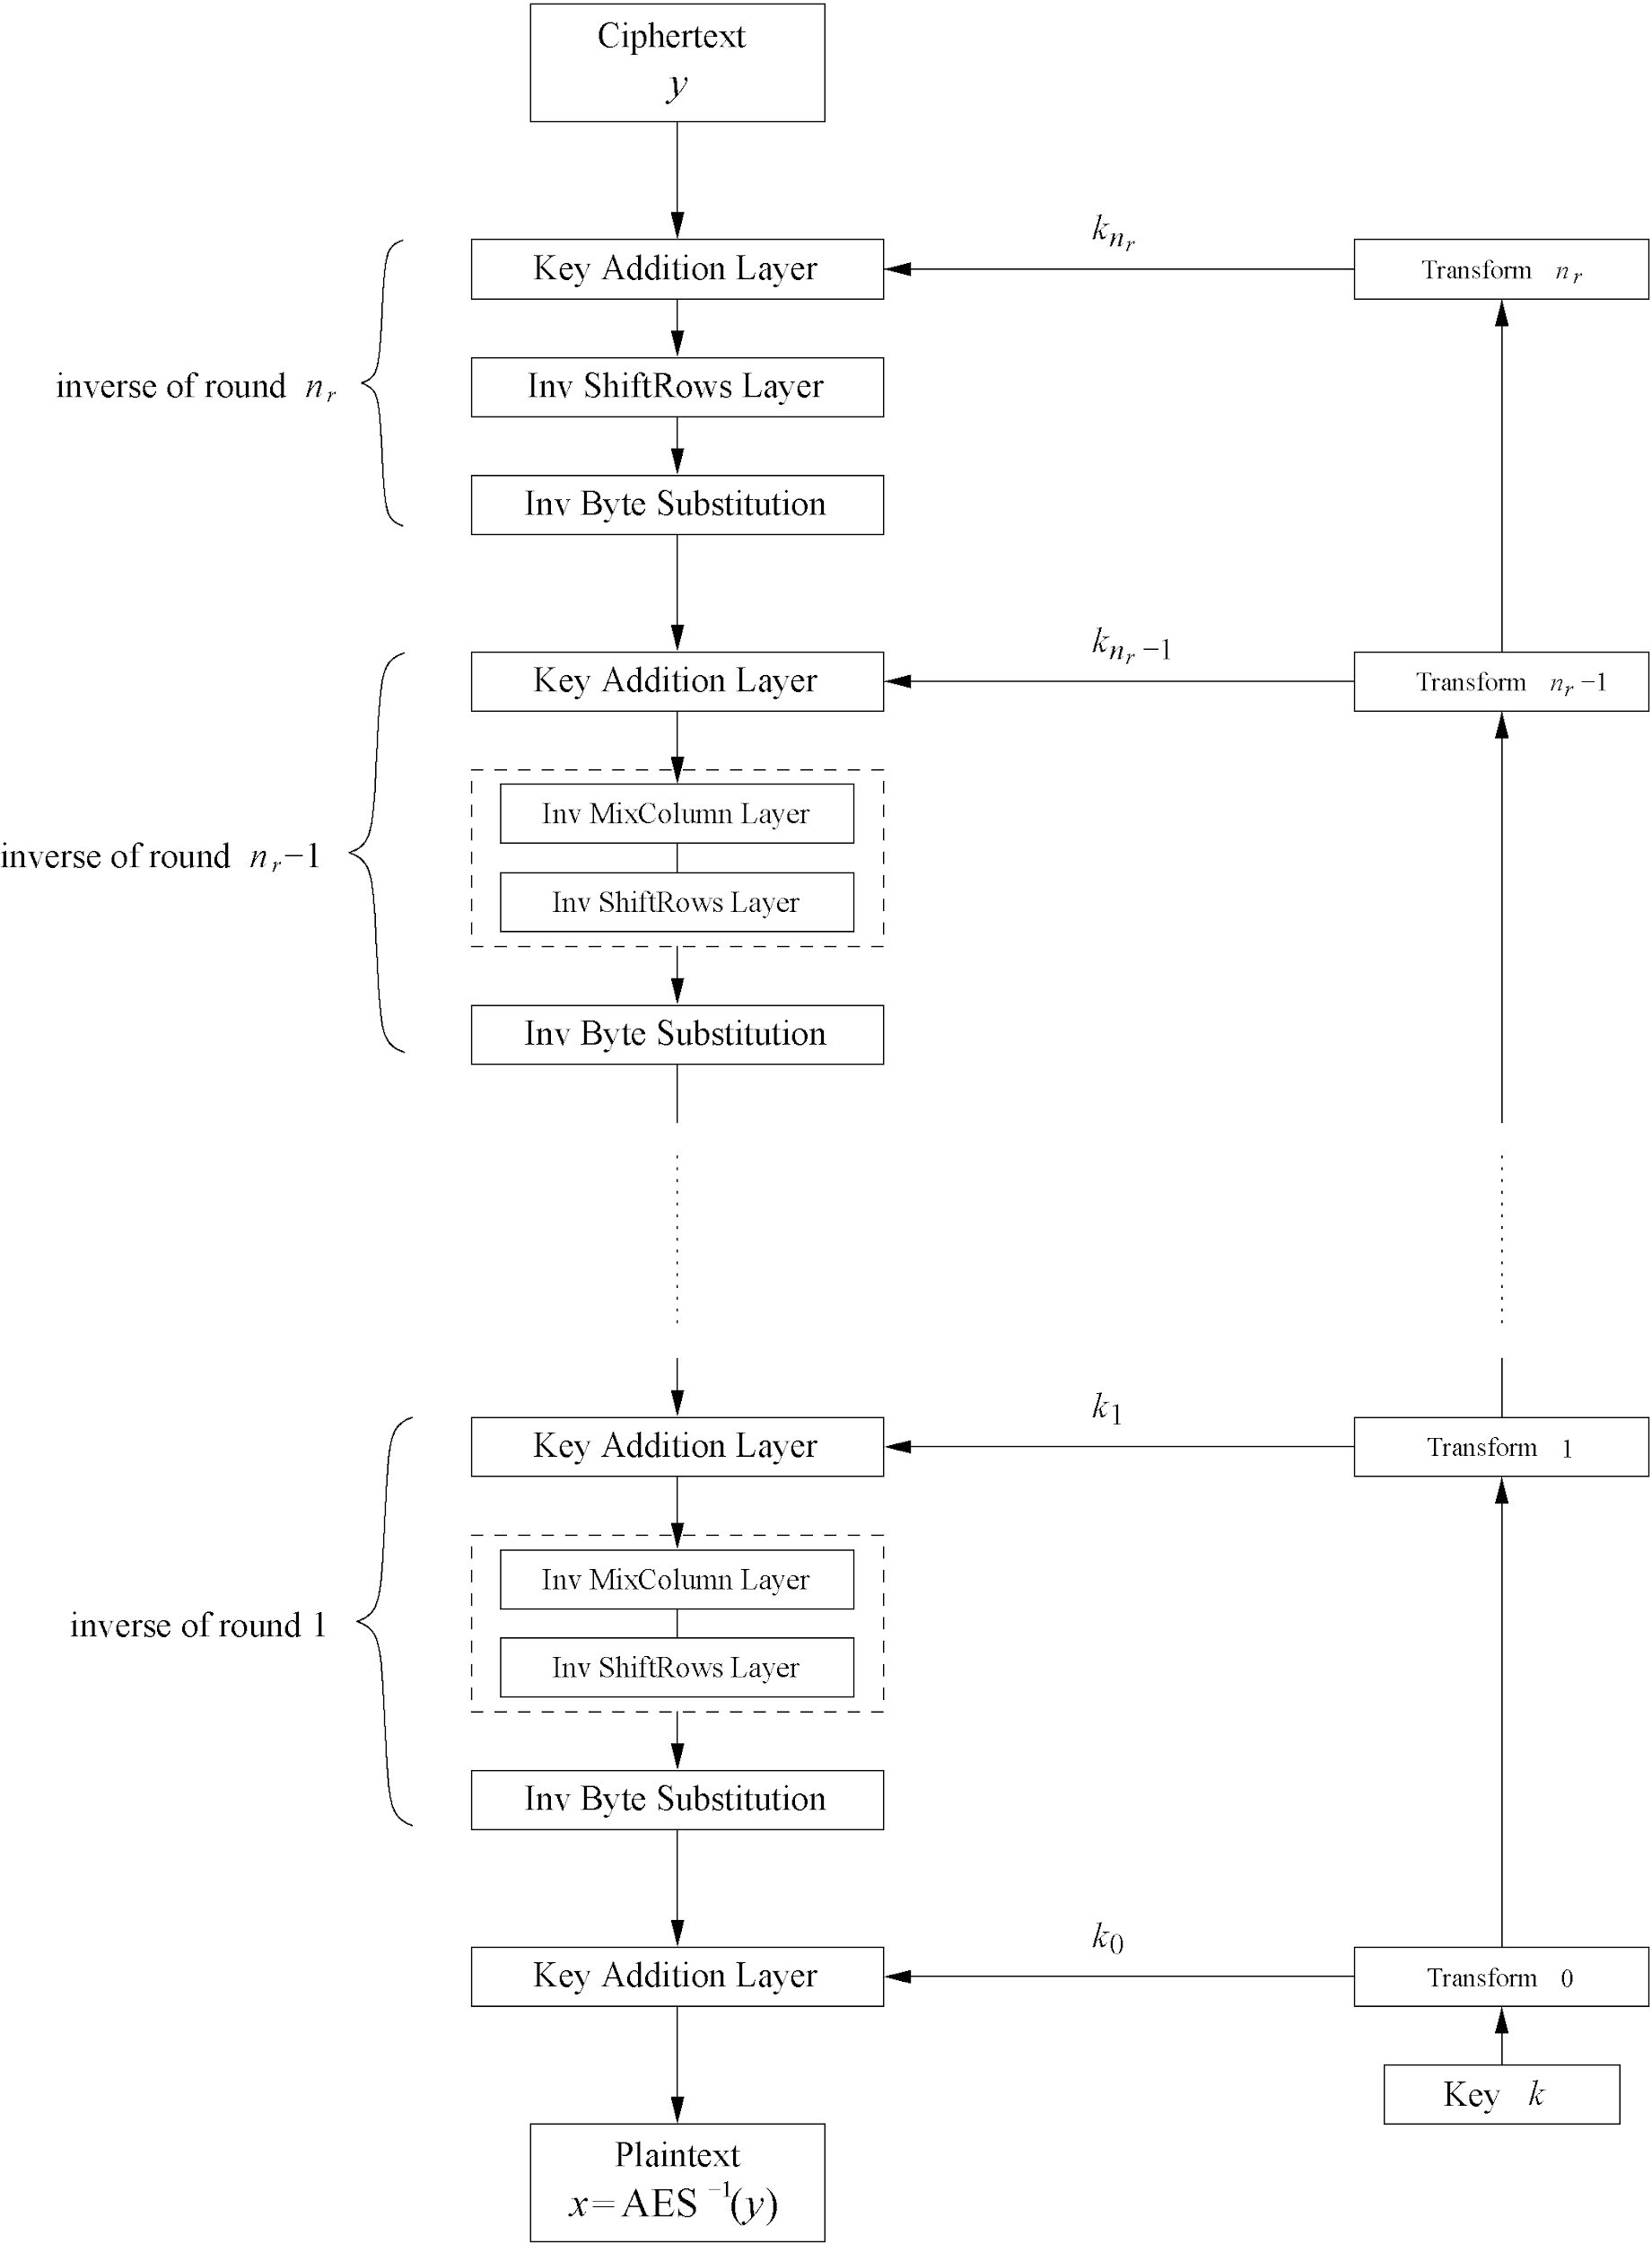
AES Decryption
AES is not based on a Feistel network
⇒ All layers must be inverted for decryption:
  MixColumn layer → Inv MixColumn layer
  ShiftRows layer→ Inv ShiftRows layer
  Byte Substitution layer → Inv Byte Substitution layer
  Key Addition layer is its own inverse
‹#›

Slide 76
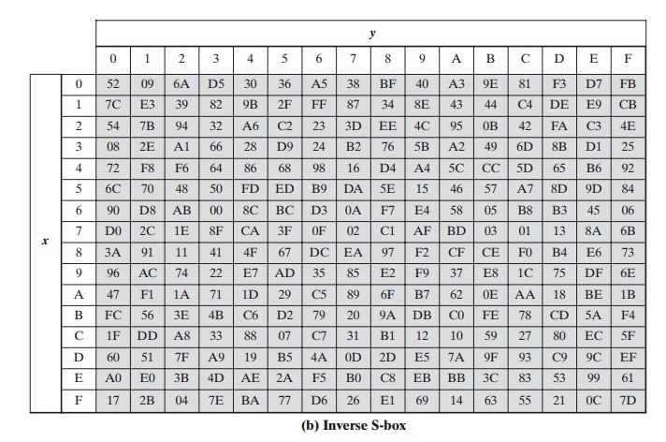
‹#›

Slide 77
A Few Other Block Ciphers
Briefly…
  IDEA
  Blowfish
  RC6
More detailed…
  TEA
‹#›

Slide 78
End of segment
‹#›

Slide 79
Modes of Operation
Many modes ⎯ we discuss 3 most popular
Electronic Codebook (ECB) mode
  Encrypt each block independently
  Most obvious approach, but a bad idea
Cipher Block Chaining (CBC) mode
  Chain the blocks together
  More secure than ECB, virtually no extra work
Counter Mode (CTR) mode
  Block ciphers acts like a stream cipher
  Popular for random access
‹#›

Slide 80
Data Integrity
Integrity ⎯ detect unauthorized writing (i.e., detect unauthorized mod of data)
Example: Inter-bank fund transfers
  Confidentiality may be nice, integrity is critical
Encryption provides confidentiality (prevents unauthorized disclosure)
Encryption alone does not provide integrity
  One-time pad, ECB cut-and-paste, etc., etc.
‹#›

Slide 81
MAC
Message Authentication Code (MAC)
  Used for data integrity
  Integrity not the same as confidentiality
MAC is computed as CBC residue
  That is, compute CBC encryption, saving only final ciphertext block, the MAC
  The MAC serves as a cryptographic checksum for data
‹#›

Slide 82
MAC Computation
MAC computation (assuming N blocks)
C₀ = E(IV ⊕ P₀, K),
C₁ = E(C₀ ⊕ P₁, K),
C₂ = E(C₁ ⊕ P₂, K),…
C_{N−1} = E(C_{N−2} ⊕ P_{N−1}, K) = MAC
Send IV, P₀, P₁, …, P_{N−1} and MAC
Receiver does same computation and verifies that result agrees with MAC
Both sender and receiver must know K
‹#›

Slide 83
Does a MAC work?
Suppose Alice has 4 plaintext blocks
Alice computes
C₀ = E(IV⊕P₀, K), C₁ = E(C₀⊕P₁, K),
C₂ = E(C₁⊕P₂, K), C₃ = E(C₂⊕P₃, K) = MAC
Alice sends IV, P₀, P₁, P₂, P₃ and MAC to Bob
Suppose Trudy changes P₁ to X
Bob computes
C₀ = E(IV⊕P₀, K), C₁ = E(C₀⊕X, K),
C₂ = E(C₁⊕P₂, K), C₃ = E(C₂⊕P₃, K) = MAC ≠ MAC
It works since error propagates into MAC
Trudy can’t make MAC == MAC without K
‹#›

Slide 84
Confidentiality and Integrity
Encrypt with one key, MAC with another key
Why not use the same key?
  Send last encrypted block (MAC) twice?
  This cannot add any security!
Using different keys to encrypt and compute MAC works, even if keys are related
  But, twice as much work as encryption alone
  Can do a little better ⎯ about 1.5 “encryptions”
Confidentiality and integrity with same work as one encryption is a research topic
‹#›

Slide 85
Uses for Symmetric Crypto
Confidentiality
  Transmitting data over insecure channel
  Secure storage on insecure media
Integrity (MAC)
Authentication protocols (later…)
Anything you can do with a hash function (upcoming chapter…)
‹#›

Slide 86
End
‹#›

